Slide 1
DevOps for AI
CI/CD for Models
For application developers + data scientists

Slide 2
Intro
DevOps is the standard way to manage application lifecycles through a pipeline of code, test, build, deploy (CI/CD cycle).
Infusing AI into this lifecycle brings new challenges and changes to the DevOps pipeline.
A CI/CD solution for AI requires supporting:
Reproducibility of data → model
Validation of model (does it meet quality bar, A/B comparison)
Storage, versioning (track lineage and evolution of model over time)
Deployment, tracking, data collection (across intelligent cloud + edge)

Slide 3
Intro to AI & the model lifecycle
The Journey

Slide 4







Three Steps in Building AI Models
Prepare
Experiment
Deploy
…
Prepare Data
Build model (your favorite IDE)
Train & Test Model
Register and Manage Model
Build Image
Deploy Service
Monitor Model

Slide 5
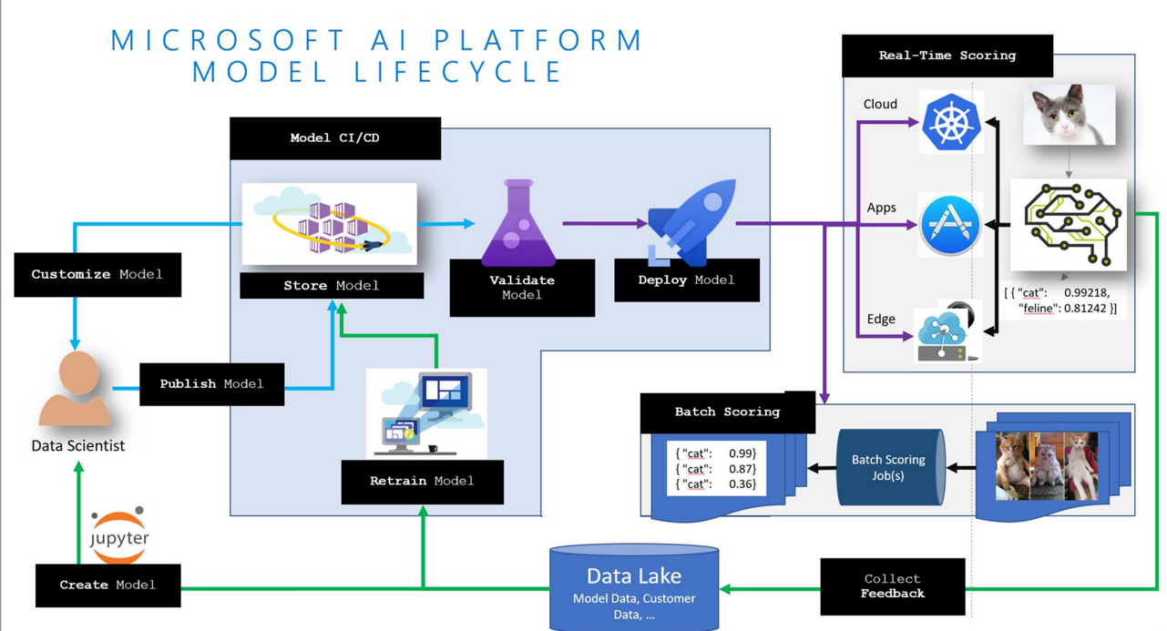

Slide 6
App Developer & Data Scientist Lifecycle Convergence

Slide 7

programming
machine learning
vs.
algorithm
answer
algorithm
answer
input
input

Slide 8
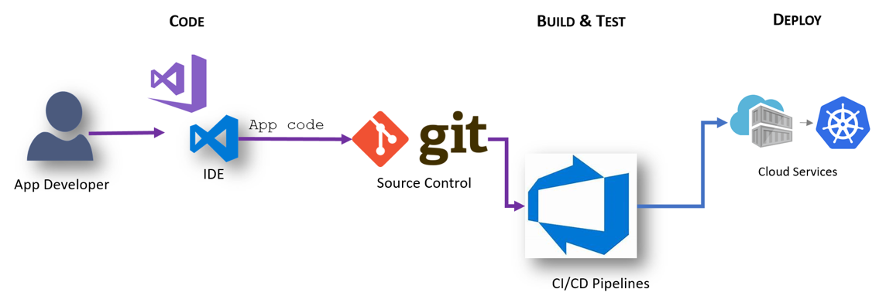
Workflow: App Developer
Basic Workflow: App Developer
Workflow: App Developer
Notes:
Test Scenario in Build is unit test
Integration is E2E tests, testing complete application.

Slide 9
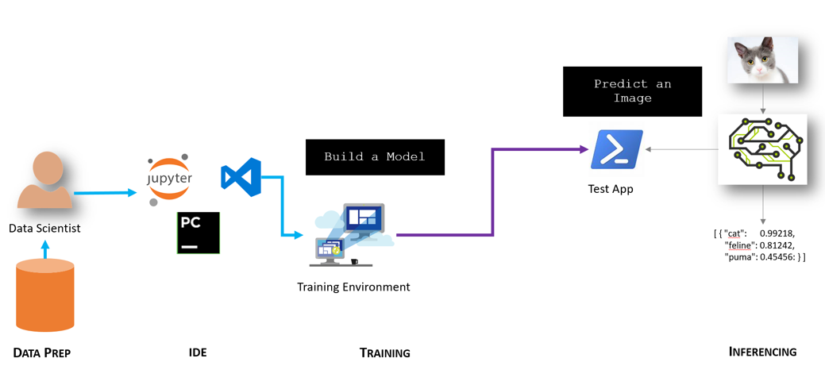
Workflow: Data Scientist
Basic Workflow: Data Scientist
Workflow: App Developer
Notes:
Data scientists spend a lot of time shaping data, figuring out which features are most relevant to their scenario, and figuring out which algorithm is best to solve their problem.
Test Scenario in Build is unit test
Integration is E2E tests, testing complete application.
Challenges of ML in DevOps
Testing of Stastical results – pick one (accuracy, f1 or other) and stick to it. Have goal to improve that metric. Second aspect is testing the dataset itself, have correct split between training and testing.
In ML change in results can happen without change in code (eg. Retraining) and it should produce newer releases. Github can’t store datasets, so it has to be stored in a storage location.
Time to train the classifier – Re-Training can take hours or days, can’t really train on each build, but have to do it nightly, weekly or biweekly.
Architectural approaches –
Include full processing into your CI/CD cycle.
Carve out ML into a separate service, as different services can have different stack.

Slide 10
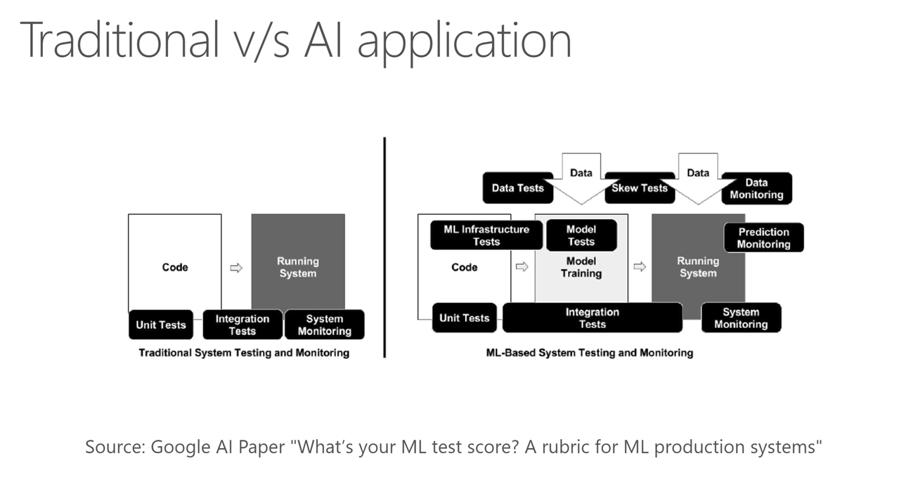

Slide 11
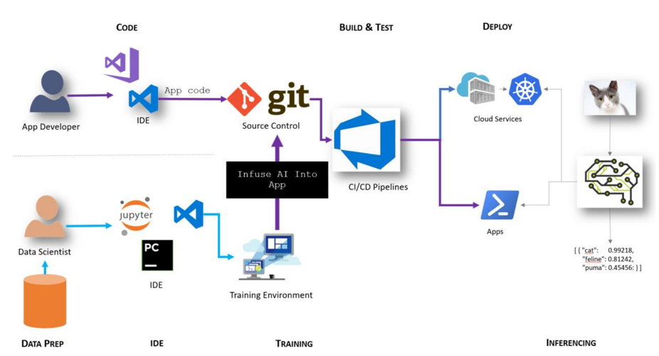
Step 1 – Infuse AI into App

Slide 12
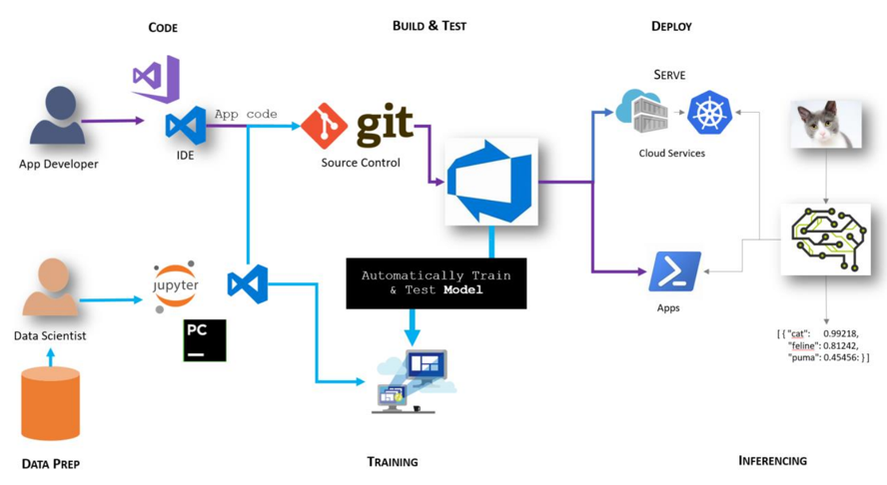
Step 2 – Automate Model Training

Slide 13
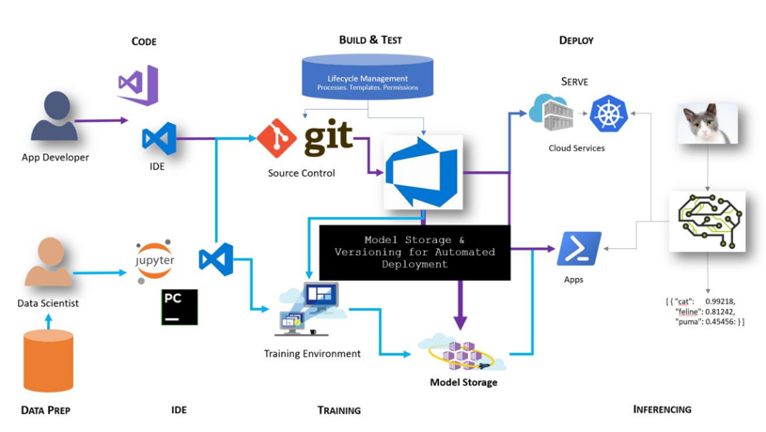
Step 3 – Store, Version and Validate Models

Slide 14
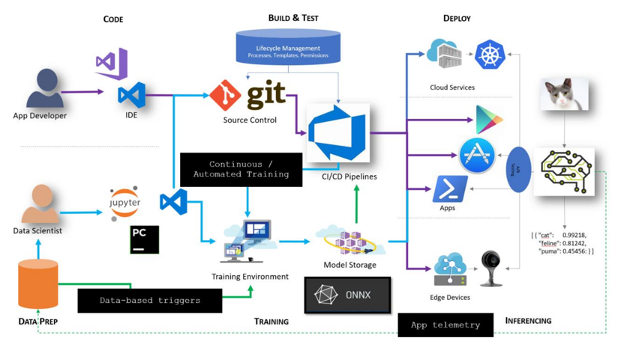
Step 4 – Automate Model Release
Notes:
Data prep needs to be versioned as part of training as well
Wrangling / training / inferencing
Ingress controller for routing
Traffic from k8s / aml is looking at istio
Confuse.com in UK

Slide 15
















App Developers and Data Scientists Together
Update Application
Cntk/Tf/Scikit
Keras/ …
Deploy Application
Cloud Services
App Developer
IDE
DevOps Pipeline
Validate & Flight Model + App
Consume Model
Deploy Model
Apps
Customize Model
Model Store
Predict
Edge Devices
Publish Model
[ { "cat": 0.99218,
"feline": 0.81242 }]
Data Scientist
Retrain Model
Model Telemetry
Collect Feedback
IDE
Notes:
Make this slide animation.
Developer work on the IDE of their choice on the application code.
They commit the code to source control of their choice (VSTS has good support for various source controls)
Separately, Data scientist work on developing their model.
Once happy they publish the model to a model repository (we can extend this with Vienna)
A build is kicked off in VSTS based on the commit in GitHub.
VSTS Build pipeline pulls the latest model from Blob container (can be extended with Vienna Model Management Service) and creates a container.
VSTS pushes the image to private image repository in Azure Container Registry
On a set schedule (nightly), release pipeline is kicked off.
Latest image from ACR is pulled and deployed across Kubernetes cluster on ACS.
Users request for the app goes through DNS server.
DNS server passes the request to load balancer and sends the response back to user.

Slide 16
Pain Points for Data Scientists & DevOps
Need to solve ML problem quickly.
ML stack might be different from rest of the application stack.
Lots of Glue code.
Testing accuracy of ML model.
ML code is not always version controlled.
Hard to reproduce models
Integrating model into application can take weeks
Need to re-write featurizing and scoring code multiple times (in different languages)
Want to start using customer data to build models
Hard to track breaking changes
Notes:
Most of the focus of enterprises has been around
Model Source control
Model Validation
Model versioning and storage
Model Deployment
There are various companies trying to solve this problem and making it easier for user.
AWS Sagemaker, Azure ML, ML Flow etc.
TDSP provides a way for DS to work together, this is our effort to provide a way to include output from DS into enterprise AI development.

Slide 17
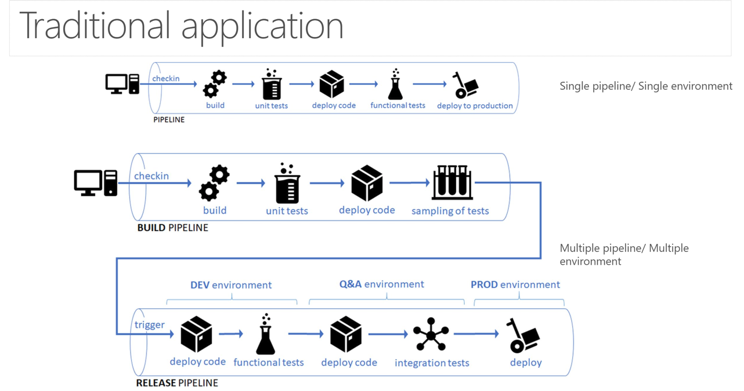

Slide 18
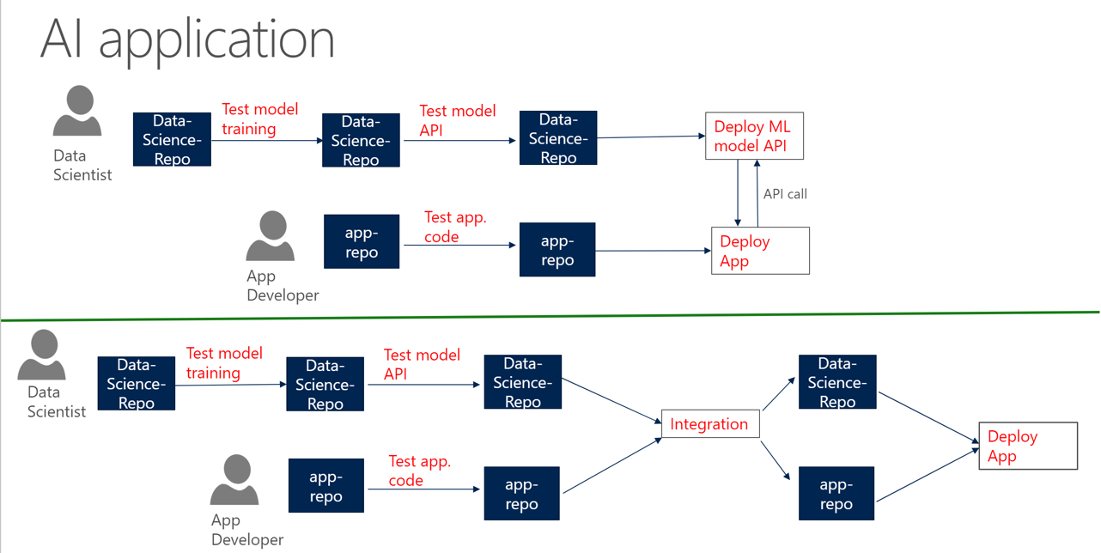

Slide 19
Proposed process
CI/CD for models

Slide 20
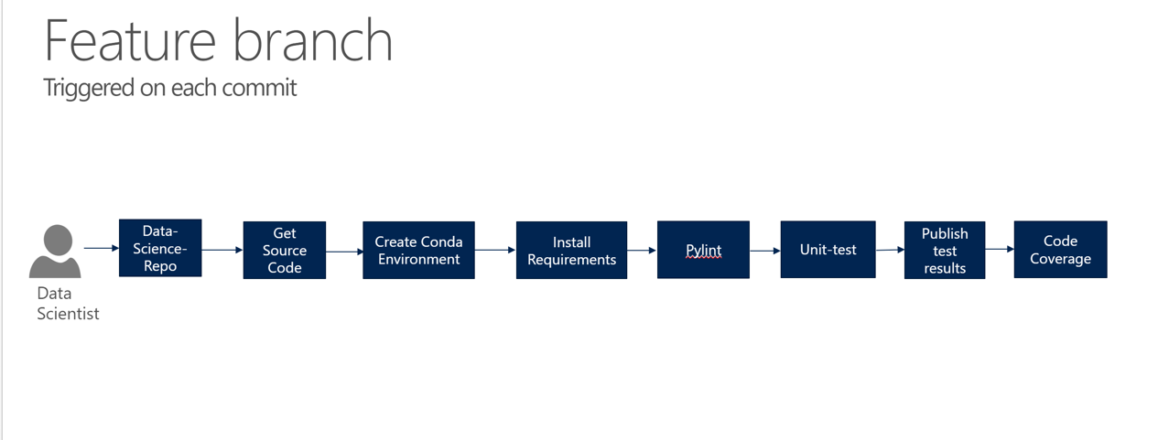

Slide 21
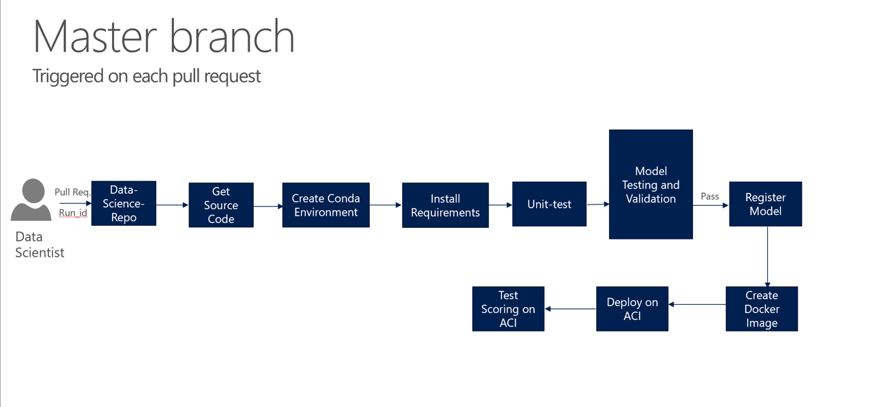

Slide 22
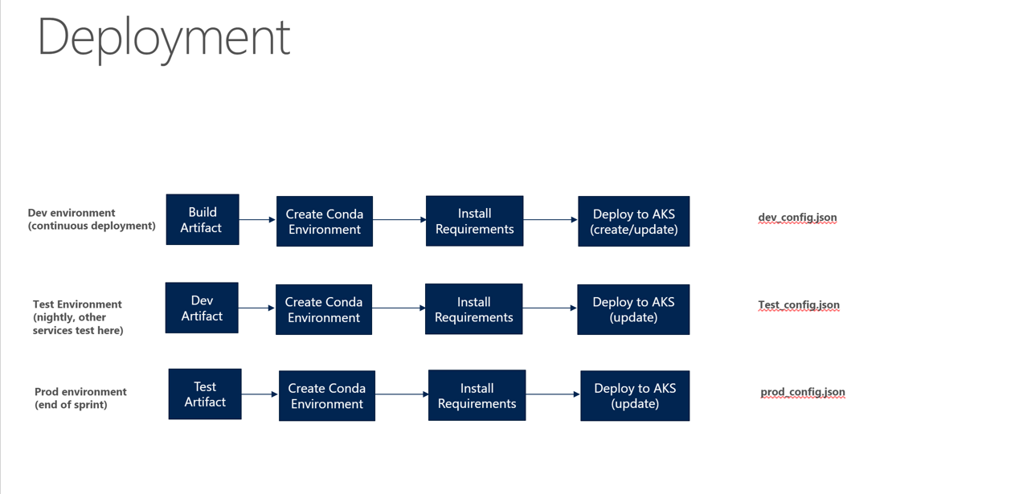
We recommend the following deployment targets:
ACI (for dev-test scenarios)
AKS (for real-time services)
Batch AI (for batch scoring, as part of larger pipelines, …)

Slide 23
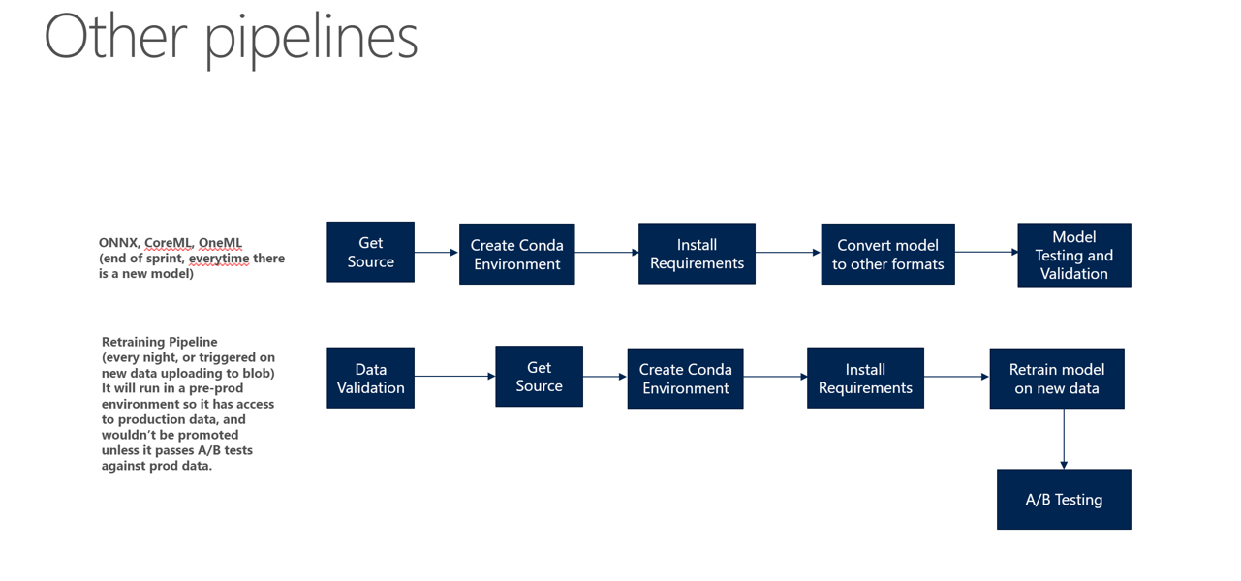

Slide 24
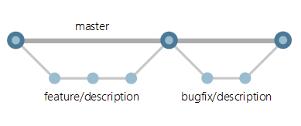
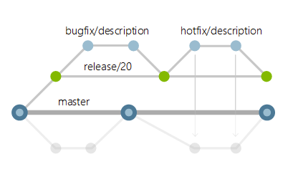
Refresher: Branch Management for Git
Notes:
Refer to John Ehringler’s past presentation on Git with TDSP
https://microsoft.sharepoint.com/teams/Boston_Data_Science/Shared%20Documents/Forms/AllItems.aspx?viewpath=%2Fteams%2FBoston%5FData%5FScience%2FShared%20Documents%2FForms%2FAllItems%2Easpx&id=%2Fteams%2FBoston%5FData%5FScience%2FShared%20Documents%2FTeam%2FTeam%20Danielle%2FTDSP%2FGit%20For%20TDSP%2Epptx&parent=%2Fteams%2FBoston%5FData%5FScience%2FShared%20Documents%2FTeam%2FTeam%20Danielle%2FTDSP

Slide 25
Demos
Automatic retraining and deployment to mobile (from Cognitive Services)
https://www.youtube.com/watch?v=ReG2QCbd-cE
CI/CD pipeline for models in VSTS
https://aidemos.visualstudio.com/DevOps%20for%20AI%20-%20Demo/_build

Slide 26
Focus Areas

Slide 27
AI Platform & Dev Services
EXPERIMENTATION SERVICES
MODEL MANAGEMENT SERVICES
Experiment Tuning
Experiment Tracking
Experiment Execution
Model Storage
Image Building
Service Hosting
Lifecycle Management
We integrate these platforms through CI/CD for a best in class experience.
CODING & DEVOPS TOOLS
AI COMPUTE
Spark
DSVM
Batch AI
AKS
IoT Edge
VS Tools for AI
GitHub / VSTS AI
Jupyter / Databricks AI Tools
CPU, FPGA, GPU

Slide 28
Azure Machine Learning

Slide 29



Machine Learning on Azure
Consume AI – Cognitive Services
Sophisticated pretrained models
To simplify solution development
…
Vision
Speech
Language
Search
Build AI – Azure Machine Learning Services
Popular frameworks
To build advanced deep learning solutions
Pytorch
TensorFlow
Keras
Onnx
Productive services
To empower data science and development teams
Azure Databricks
Azure Machine Learning
Machine Learning VMs
Powerful infrastructure
To accelerate deep learning
CPU
GPU
FPGA
Flexible deployment
To deploy and manage models on intelligent cloud and edge
On-premises
Cloud
Edge
Notes:
There are 5 parts of our Machine Learning portfolio:
Pre-Trained AI Models to simplify solution development Support for popular deep learning frameworks
Productive services to empower data science and development teams
Powerful infrastructure to accelerate deep learning
Flexible deployment options that span cloud, on-premises and even the edge
We’ve already gone through Cognitive Services, so lets jump to the frameworks

Slide 30




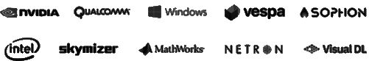
Popular frameworks Build advanced deep learning solutions
Use your favorite deep learning frameworks
without getting locked into one framework
TensorFlow
PyTorch
Scikit-Learn
ONNX
Community project created by Facebook and Microsoft
Use the best tool for the job. Train in one framework and transfer to another for inference
MXNet
Chainer
Keras
Notes:
Our approach to ML frameworks is simple.
We give customers the flexibility to choose their deep learning framework, without getting locked one framework.
To help with this we’ve created a community project in partnership with Facebook that allows customers to train in one framework and use another one for inference
Now, let me move to the ML services on Azure

Slide 31

machine learning
science-y
things
model
data
Notes:
MNIST HANDWRITTEN DIGITS

Slide 32
Azure Databricks
Azure Machine Learning
Enable collaboration between data scientists and data engineers with an interactive productive workspace
Prepare and clean data at massive scale with the language of your choice
Build and train models with pre-configured machine learning and deep learning optimized clusters
Track experiments for reproducibility
and auditing needs.
Identify and promote best performing models into production
Deploy and manage your models using containers to run them anywhere
Notes:
If customers are looking to do machine learning on big data, then Azure Databricks is a great place to start. Azure Databricks runs an optimized version of Spark which is up to 7x faster than vanilla Spark.
Their interactive notebooks are ideal for data prep + cleansing and for build & training models suing MLlib. We recently also launched a specific machine learning deep learning runtime to make distributed deep learning easy on Spark.
Azure Machine Learning services complements the experience with experiment tracking, model management and deployment.
The AML and Azure Databricks integration is in private preview today, but we are looking to release the SDKs publicly in the next couple of months.
There are real customers benefiting today by using Machine Learning to build their own AI models in Azure today.

Slide 33



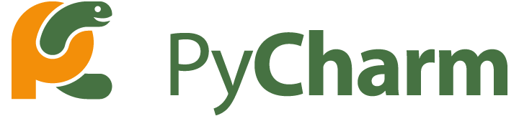


Use your favorite IDE
Azure Machine Learning
Build and train models locally, with Remote VMs or massive Batch AI clusters
Track experiments for reproducibility
and auditing needs. Identify and promote your best models
Deploy and manage your models using containers to run them anywhere
Monitor your models performance from a single location
Augment the tools that you know and love with the Azure ML SDK
Build and train models directly from your environment
Start from prebuilt packages or your own code

Slide 34
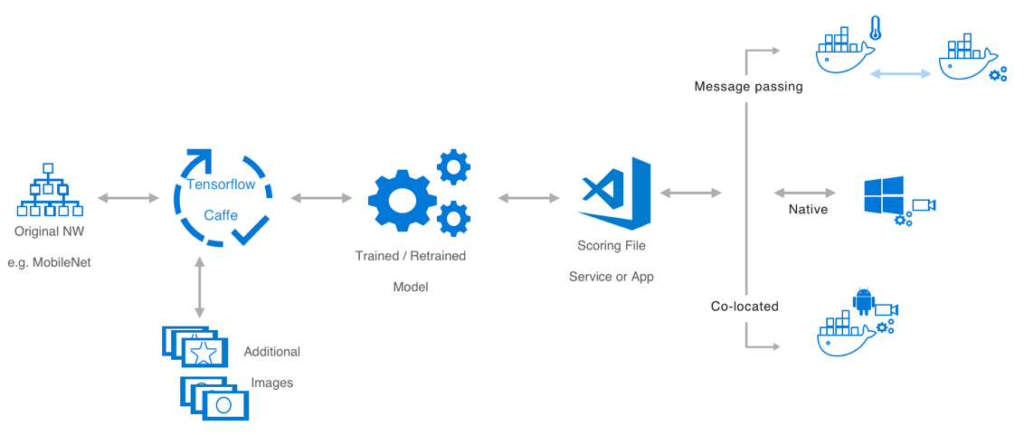
The components of a ML application
Vision AI dev kit
Vision AI dev kit

Slide 35
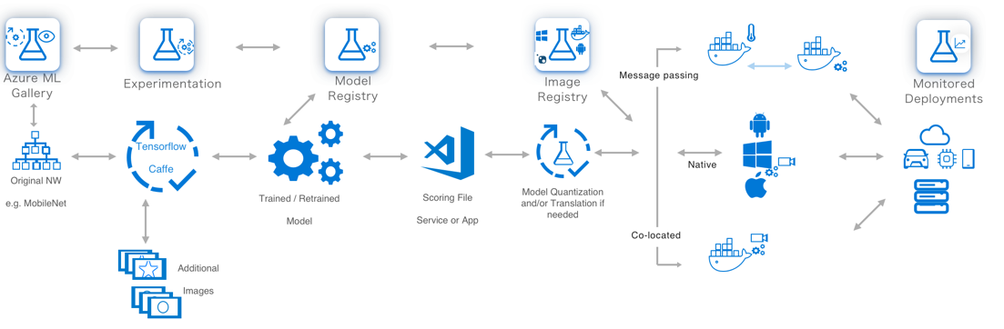
The components of a ML application

Slide 36
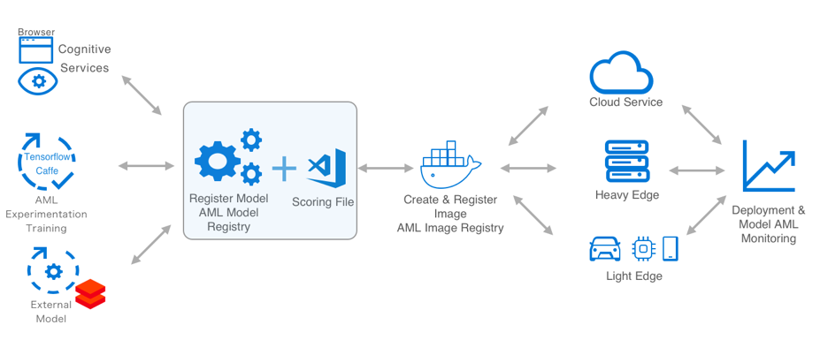
Azure Machine Learning Operationalization

Slide 37
Appendix

Slide 38
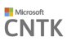









Experimentation services
Manage project dependencies
Manage training jobs locally, scaled-up or scaled-out
Service side capture of run metrics, output logs and models
Customizable run history reports, side by side run comparison and model selection
Use your favorite IDEs, editors, notebooks, and open-source frameworks
Use any framework or library
Use any tool
Use the most popular innovations
Public

Slide 39
Azure DevOps & Model CI/CD
Hosted Agents
Private Agents
Hosted – Supports Windows, Linux and MacOS.
Stateless, every build/release is done on a fresh agent instance.
No management needed.
Builds can take longer since dependency needs to be installed each time.
To speed things up, create a docker image with your dependencies and download the image each time instead of re-installing dependencies.
Any VM that is running the agent script can be attached as private agent.
If you need GPU, private agent is the only way to do so.
Faster builds since dependencies are pre-installed.
Stateful.
VM management is required.

Slide 40




Code
Publish
Consume
Build & Test
Lifecycle Management
Processes. Templates. Permissions
App code
Cloud Services
App Developer
IDE
Source Control
Validate & Deploy Model
CI/CD
Infuse AI into App
Apps
Automatically Train Model
Data Scientist
[ { "cat": 0.99218,
"feline": 0.81242,
"puma": 0.45456: } ]
IDE
Model Storage
Training Environment
Data-based triggers
Edge Devices
Data Lake
App telemetry
Notes:
Make this slide animation.
Developer work on the IDE of their choice on the application code.
They commit the code to source control of their choice (VSTS has good support for various source controls)
Separately, Data scientist work on developing their model.
Once happy they publish the model to a model repository (we can extend this with Vienna)
A build is kicked off in VSTS based on the commit in GitHub.
VSTS Build pipeline pulls the latest model from Blob container (can be extended with Vienna Model Management Service) and creates a container.
VSTS pushes the image to private image repository in Azure Container Registry
On a set schedule (nightly), release pipeline is kicked off.
Latest image from ACR is pulled and deployed across Kubernetes cluster on ACS.
Users request for the app goes through DNS server.
DNS server passes the request to load balancer and sends the response back to user.

Slide 41
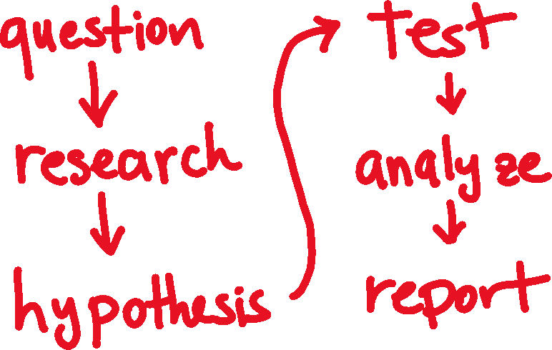
science

Slide 42

science
Notes:
Again and again

Slide 43











the team workspace - logical
Notes:
Experiments – this is where you try stuff / will have a history / track code through snapshots for every run / keep sanity (metadata)
Data Stores – where does your data live – MNIST is fine until it doesn’t fit on your hard drive, you also need to share with others, and you spilt your coffee once on your machine and lost everything
Compute – the metal where the experiments run (physical run on compute)
Models – output (just the good ones – you specify what to keep and how to version)
Images – package model with inference code and everything you need for it to run properly
Deployments – actual running models with ip addresses and everything

Slide 44












Data Science Lifecycle
The Major Buckets & What Tools People Use
Simplified (no CI/CD concepts present)
Prepare Data
Build & Train
Run
LOB
CRM
Azure Databricks
Azure Databricks
Azure ML / AKS
Graph
Mobile Apps
Azure ML
Image
Azure IoT Edge
Azure Data Lake
Social
Batch AI
IoT
Apps + insights
IoT
Ingest, Wrangle Data and Prepare Datasets for Training
Build models with many toolkits (normally Python based)
Deploy, Version, Manage & Monitor AI Models on Cloud + Apps + Edge
Cloud
Notes:
We are expanding and improving Azure Machine Learning service, by expanding to Azure Machine Learning Experimentation and Model Management services which offer a cloud, on-premises, and edge solution for data scientists and developers to bring AI everywhere, to everyone. ​
Azure Machine Learning Experimentation Service allows developers and data scientists to increase their rate of experimentation. Rapidly prototype on their desktops, then easily scale up on virtual machines or scale out using Spark clusters. These services allow developers and data scientists to proactively manage model performance, identify the best model, and promote the best model with data. Collaborate and share solutions using powerful, industry standard GIT repositories. ​
Azure Machine Learning Model Management allows developers and data scientists to deploy and manage their models everywhere. Use Docker containers to deploy models into production faster in the cloud, on-premises, or edge. Promote your best performing models into production and re-train them when their performance degrades. Deploy as real-time or high throughput batch services. ​
Leverage the best open source frameworks such as TensorFlow, Cognitive Toolkit, Spark ML, scikit-learn, and more. ​

Slide 45
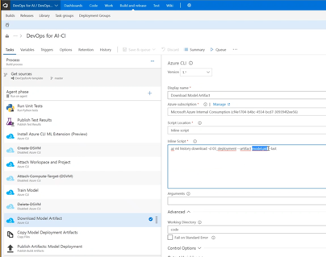
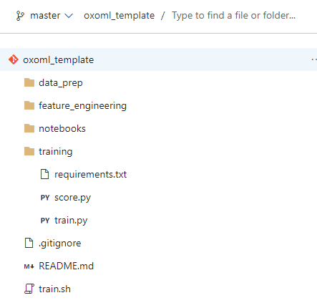
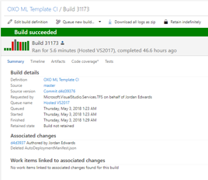
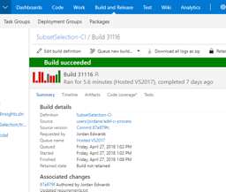
Model Source Control
Processes and procedures to make models reproducible (from source control to data retention policies)
Make it easy to work on multiple models (consistent process)
Trigger training and deployment on commit
Or whatever user specifies as a requirement

Slide 46
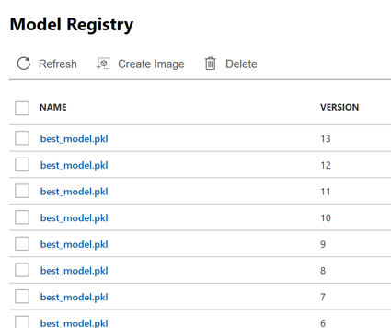
Model Versioning & Storage
Train your model with AML
Import your model from the AI Gallery
Bring your own model
ONNX – goal is to be interoperable format for models (early stages)
Provide a consistent way to discover, store, track & share models
Provide a consistent model metadata format
Provide traceability on where a model came from (which data, which experiment, where’s the code / notebook)
Track where model is running
Control who has access to what models
Private / compliant data

Slide 47
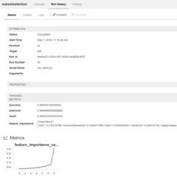
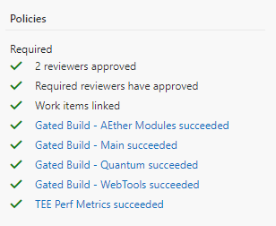
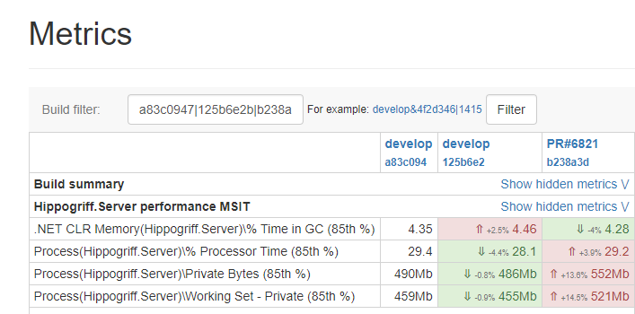
Model Governance
Profile and validate
Model in isolation
Model when embedded / optimized for application
Gate promotion of the model on validation
Assess
Functional behavior
Performance characteristics
Validate offline and online
A/B lets us test with live data

Slide 48
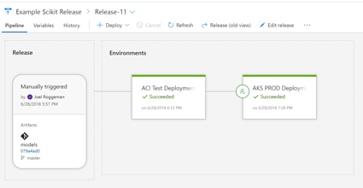
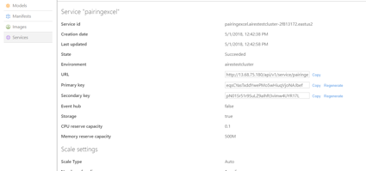
Model Deployment
Provide an efficient process to get a model build into an application or service.
Simplify the process to interact with the model (through code-generation, API specifications / interfaces or other methods)
Support a variety of inferencing targets
Cloud Services
Mobile / Embedded Applications
Edge Devices
Convert / quantize / optimize models for target platform
Manage secrets / service endpoints to remove friction from configuring the release process.
Control the rollout of your models (with A/B) (compliant + safe)
GOAL: Let customers focus on ML, not devops

Slide 49
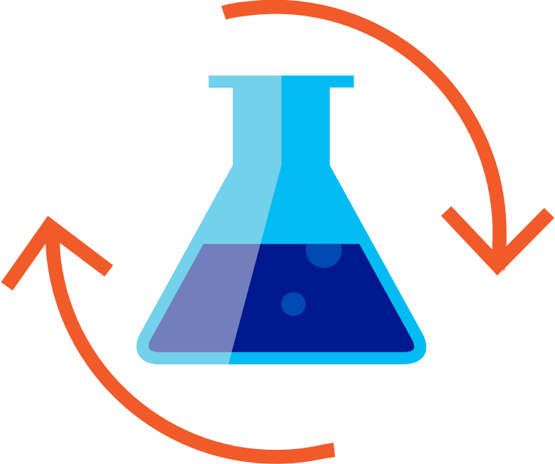

Custom AI
Building your own AI models for Transforming Data into Intelligence
Prepare Data
Build & Train
Deploy
Notes:
Let’s now talk about building your own AI models to transform data into intelligence.
It usually involves three steps – preparing the data to learn from, building and training machine learning models, and deploying these models in production applications.
For each step of these, we have industry leading offerings on Azure.

Slide 50
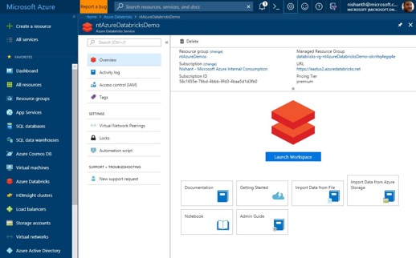
Building your own AI models
Step 1: Prepare Data
Azure Databricks
Apache® Spark™ based analytics platform optimized for Azure
Quickly launch and scale Spark on demand
Rich interactive workspace and notebooks
Seamless integration with all Azure data services
Notes:
When you want to prepare massive amounts of data, one of the best platforms is Azure Databricks.
It is an Apache Spark based analytics platform optimized for Azure.
It allows you to do distributed in-memory data transformation and analytics.
It has a rich interactive workspace and notebooks to do development.
And it has seamless integration with all key Azure data services, such as Azure Storage, databases and data warehouses.

Slide 51
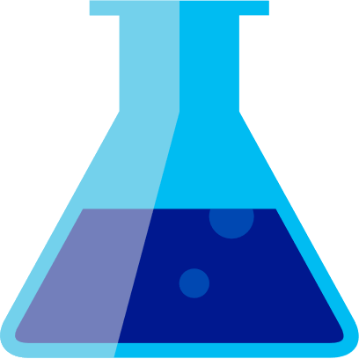
Building your own AI models
Step 2: Build and Train
Azure Machine Learning
Broad frameworks and tools support: → TensorFlow, Cognitive Toolkit, Caffe2, Keras, MxNET, PyTorch
Scale training from 1 → 100,000’s of servers
Azure ML Python SDK
Azure ML packages: → Computer Vision, Text, Forecasting
Notes:
For step 2 of Build & Train, Azure Machine Learning is the way to go.
You can use frameworks and tools of your choice for ML.
You can run training and experimentation runs across large numbers of VMs on the cloud.
The Azure ML Python SDK provides a single control plane API to Provisioning Compute, Model Training, Model Deployment and Scoring entirely in Python.
Azure ML packages provide a rich set of Python pip-installable extensions that simplify development.
It has many pre-built features and easy to use libraries for common scenarios in computer vision, text analytics and forecasting.

Slide 52
Building your own AI models
Step 3: Deploy
Azure Kubernetes Service (AKS)
Azure Batch
Azure Machine Learning
Docker Containers
Azure IoT Edge
Any other container host…
Notes:
One of the unique differentiations of Azure ML is the ease of deployment.
With one or two commands in Python, you can package up a model as a docker container.
You can run these docker containers on AKS, Azure Batch, Azure IoT Edge for edge devices.
Or any other container host.
Your models are not tied to the cloud – you can take them anywhere – containerized and ready to deploy next to the applications.
Also, the Azure ML Model Management allows you to manage their models everywhere.
You can promote your best performing models into production and re-train them when their performance degrades.

